Slide 1
Events, props, arrays in react
Bojan Angjeleski - Semos

Slide 2
Responding to events
React lets you add event handlers to your JSX. Event handlers are your own functions that will be triggered in response to interactions like clicking, hovering, focusing form inputs, and so on.

Slide 3
You will learn
Different ways to write an event handler
How events propagate and how to stop them
Arrays of objects and function map()

Slide 4
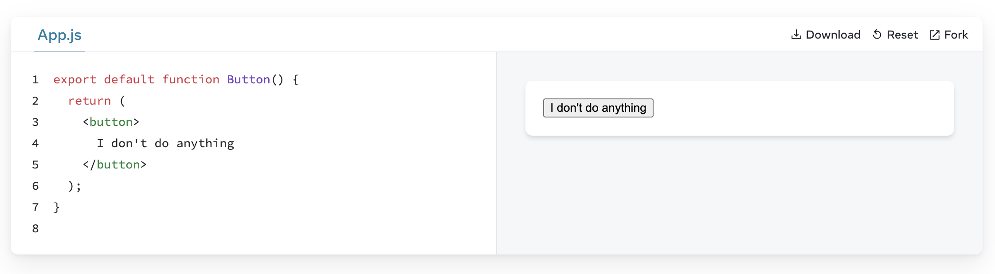
Adding event handlers
To add an event handler, you will first define a function and then pass it as a prop to the appropriate JSX tag. For example, here is a button that doesn’t do anything yet:

Slide 5
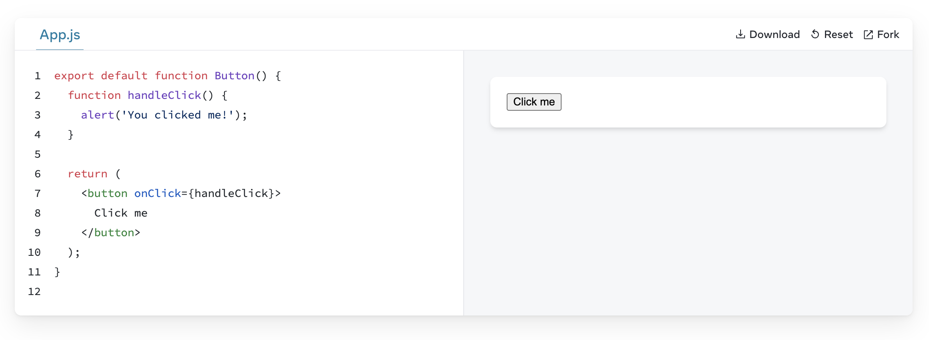
Adding event handlers
You can make it show a message when a user clicks by following these three steps:
Declare a function called handleClick inside your Button component.
Implement the logic inside that function (use alert to show the message).
Add onClick={handleClick} to the <button> JSX.

Slide 6
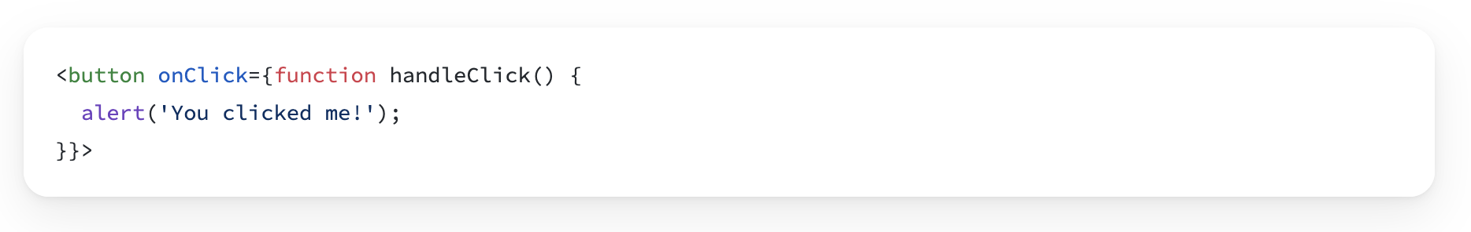
Adding event handlers
You defined the handleClick function and then passed it as a prop to <button>. handleClick is an event handler. Event handler functions:
Are usually defined inside your components.
Have names that start with handle, followed by the name of the event.
By convention, it is common to name event handlers as handle followed by the event name. You’ll often see onClick={handleClick}, onMouseEnter={handleMouseEnter}, and so on.
Alternatively, you can define an event handler inline in the JSX:

Slide 7
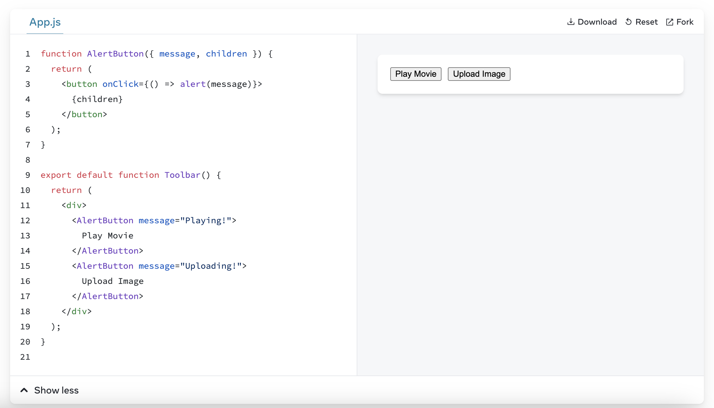
Rendering props in event handlers
Because event handlers are declared inside of a component, they have access to the component’s props. Here is a button that, when clicked, shows an alert with its message prop:

Slide 8
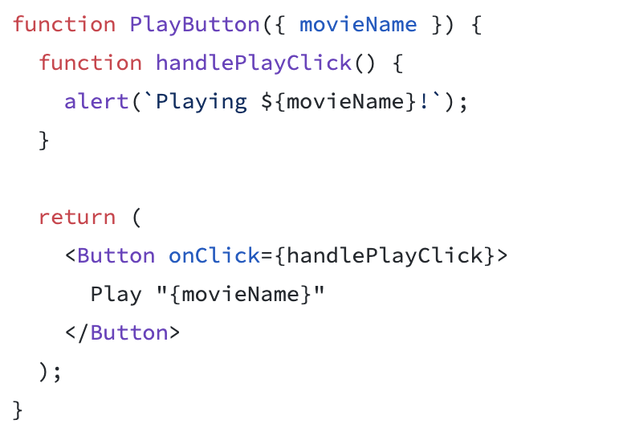
Passing event handlers as props
Often you’ll want the parent component to specify a child’s event handler. Consider buttons: depending on where you’re using a Button component, you might want to execute a different function—perhaps one plays a movie and another uploads an image.
To do this, pass a prop the component receives from its parent as the event handler like so

Slide 9
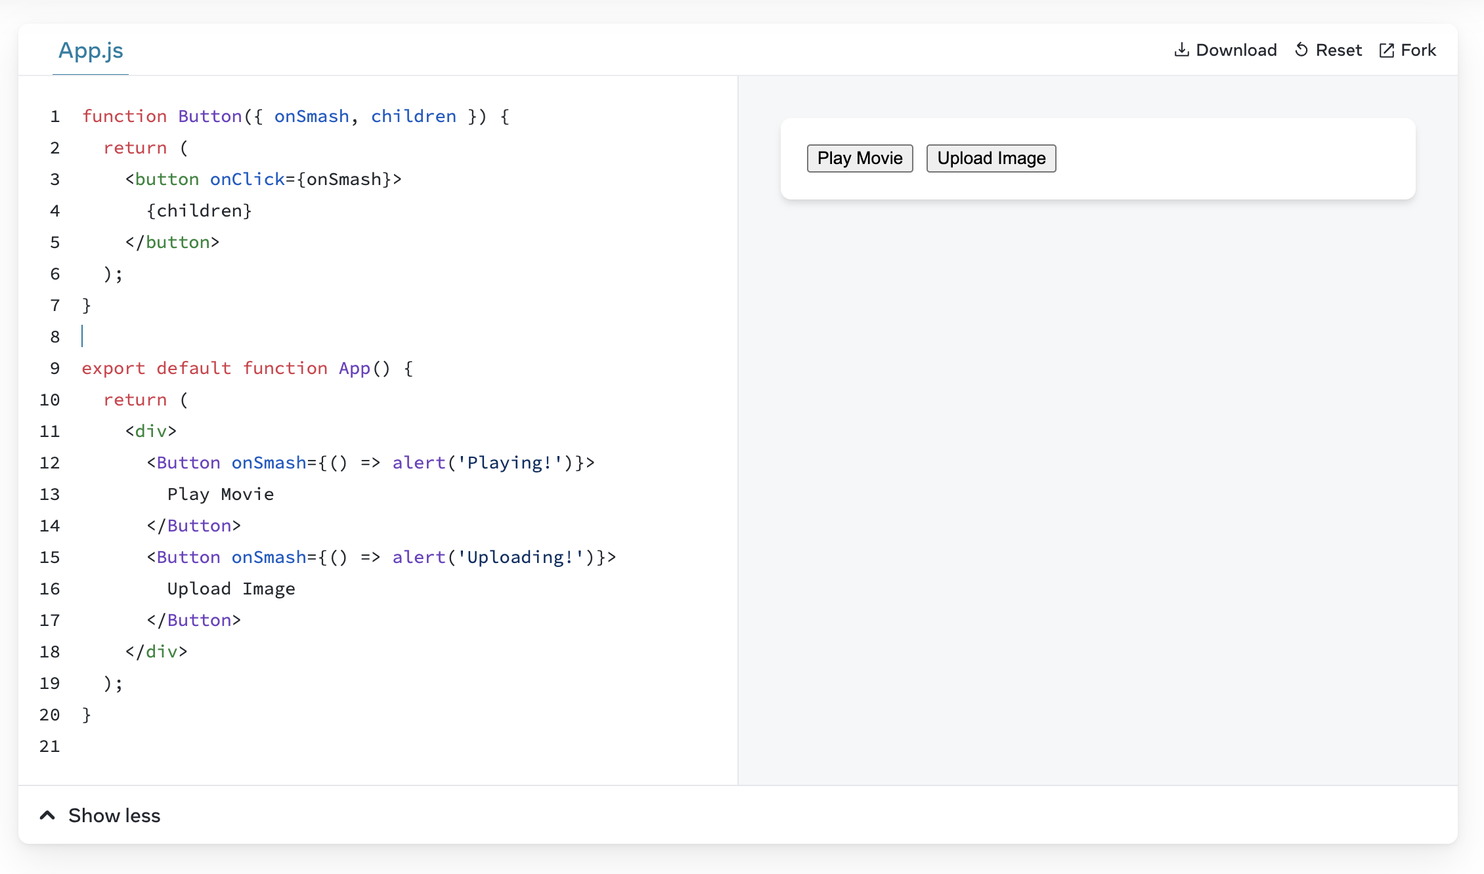
Naming event handler props
Built-in components like <button> and <div> only support browser event names like onClick. However, when you’re building your own components, you can name their event handler props any way that you like.
By convention, event handler props should start with on, followed by a capital letter.
For example, the Button component’s onClick prop could have been called onSmash:

Slide 10
Naming event handler props
Built-in components like <button> and <div> only support browser event names like onClick. However, when you’re building your own components, you can name their event handler props any way that you like.
By convention, event handler props should start with on, followed by a capital letter.
For example, the Button component’s onClick prop could have been called onSmash:

Slide 11
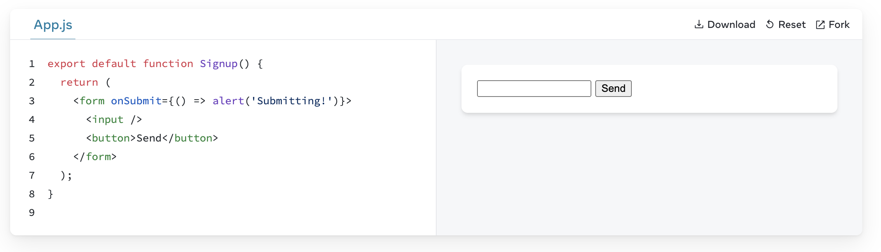
Preventing default behavior
Some browser events have default behavior associated with them. For example, a <form> submit event, which happens when a button inside of it is clicked, will reload the whole page by default:

Slide 12
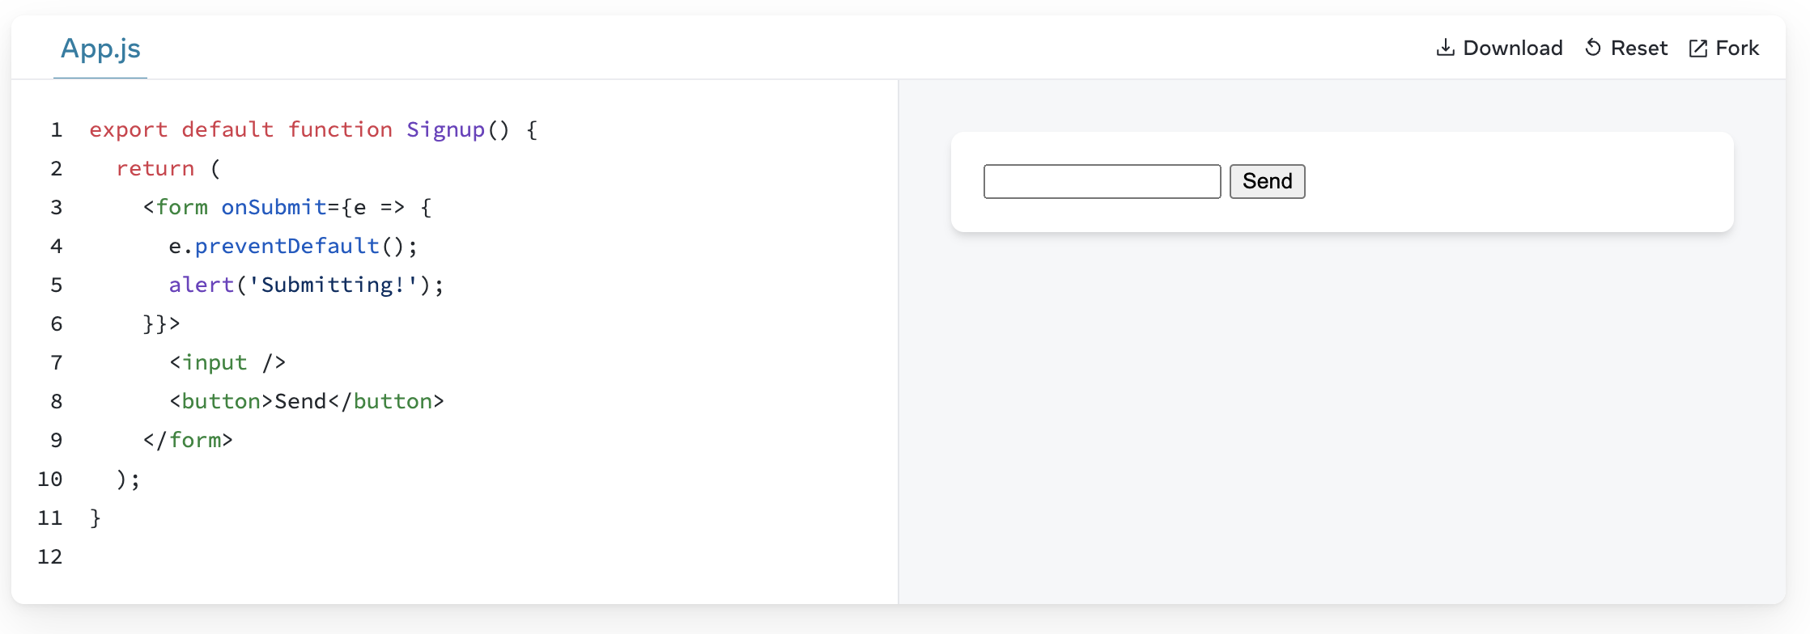
Preventing default behavior
You can call e.preventDefault() on the event object to stop this from happening:

Slide 13
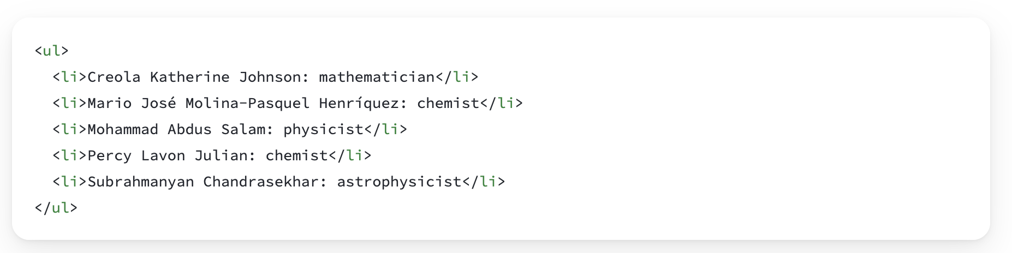
Rendering data from arrays
Say that you have a list of content.

Slide 14
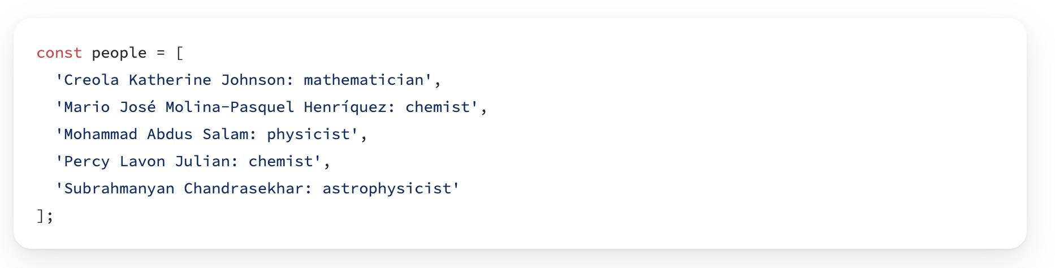
Rendering data from arrays
The only difference among those list items is their contents, their data. You will often need to show several instances of the same component using different data when building interfaces: from lists of comments to galleries of profile images. In these situations, you can store that data in JavaScript objects and arrays and use methods like map() and filter() to render lists of components from them.
Here’s a short example of how to generate a list of items from an array:
Move the data into an array:

Slide 15
Rendering data from arrays
Map the people members into a new array of JSX nodes, listItems:
Return listItems from your component wrapped in a <ul>:

Slide 16
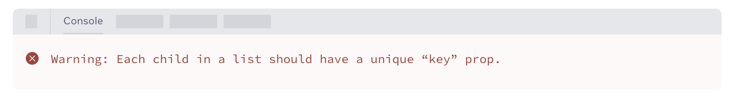
Keeping list items in order with key
Notice that all the sandboxes above show an error in the console:
You need to give each array item a key — a string or a number that uniquely identifies it among other items in that array:

Slide 17
Keeping list items in order with key
JSX elements directly inside a map() call always need keys!
Keys tell React which array item each component corresponds to, so that it can match them up later. This becomes important if your array items can move (e.g. due to sorting), get inserted, or get deleted. A well-chosen key helps React infer what exactly has happened, and make the correct updates to the DOM tree.
Rather than generating keys on the fly, you should include them in your data:

